Slide 1


Managing Web Maps and Layers Using ArcGIS API for Python
Nanae Aubry
John Yaist
2022 ESRI DEVELOPER SUMMIT
Notes:
2022 Esri Developer Summit

Slide 2

Slides and Notebooks – will be available!
After the Event!
Esri Proceedings site - Slides
ArcGIS API for Python Public Repo – Notebooks
On the conference_talks in the talks directory

Slide 3
Agenda
Web Map
Definition – conceptually and physically
Demo
Author a WebMap – Basemaps and Layers
WebMap Content
The WebMap Specification
Outline of Topics

Slide 4

Agenda
Work with a Web Map
API Classes
WebMap
MapView
Edit existing Web Map
Popups
Working with Web Map content
Switching Layers
Cloning Web Maps
Con’t

Slide 5

Web Map
Definition

Slide 6

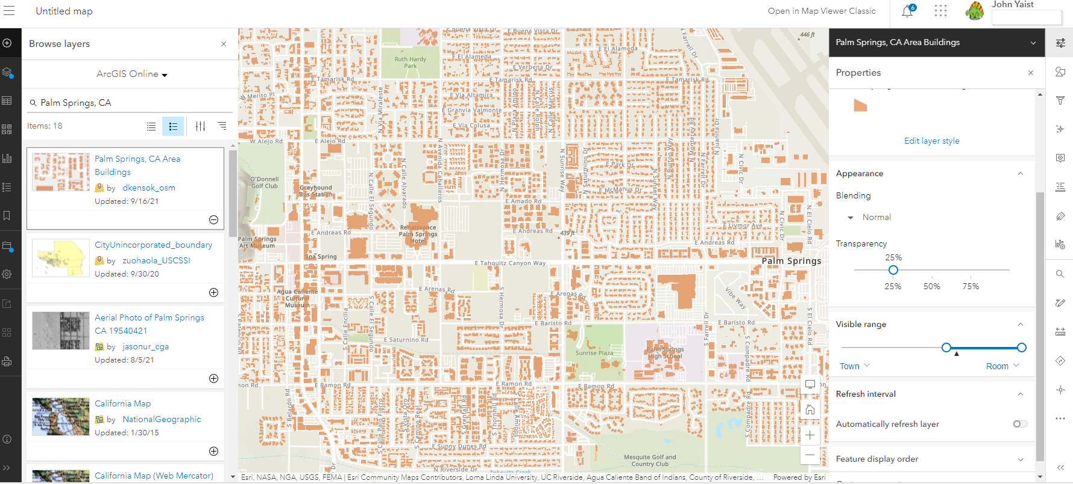
Web Map: What is it?
Framework for geographic data
Conceptually:
Interactive display of geographic information
Web accessibility
ArcGIS Online or ArcGIS Pro creation
Sharable across ArcGIS Platform
Physically:
Content Item
Added to an organization’s portal
Text-based item:
JSON object specifying collection of layers in 2D format

Slide 7

API Classes for Creating new Web Maps
MapView
WebMap

Slide 8

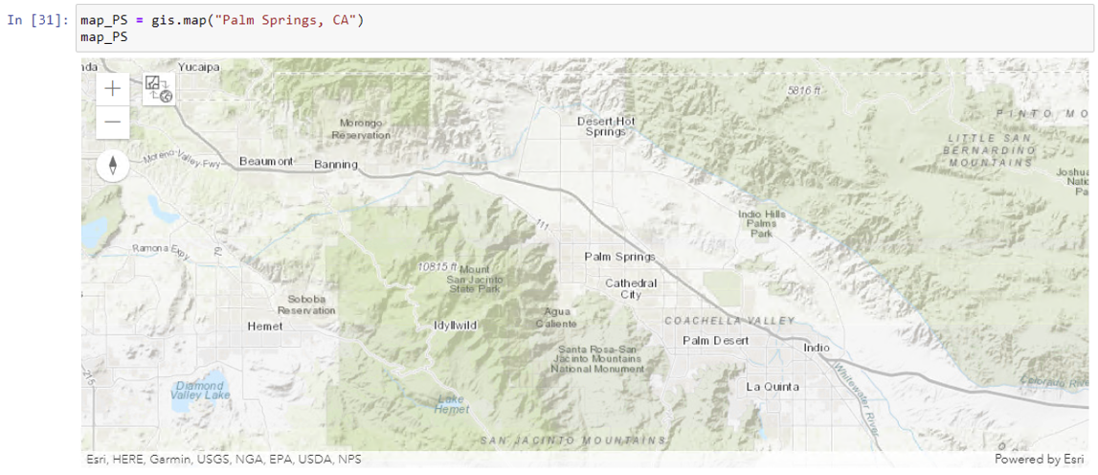
MapView arcgis.widgets module
Initialize with: the map() method of the GIS class

Slide 9
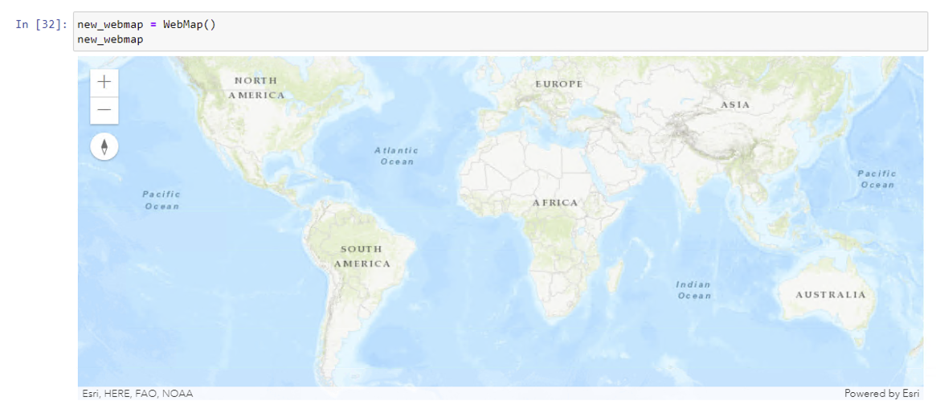
WebMap arcgis.mapping module
Initialize with the WebMap class

Slide 10


Demo: Author a Web Map
Nanae Aubry

Slide 11
Web Map Content
What’s in it?

Slide 12
WebMap Content
What’s in it?
Layers –
Basemap
Operational Layers
hosted and shared throughout ArcGIS Online
referenced externally
added directly to the map
Extent
Navigation tools to pan and zoom
Symbols and Styling

Slide 13
The WebMap Specification
The Blueprint
JSON object defining:
Configuration settings
Content
Adhere to this so your application can:
Create
Edit
Render

Slide 14
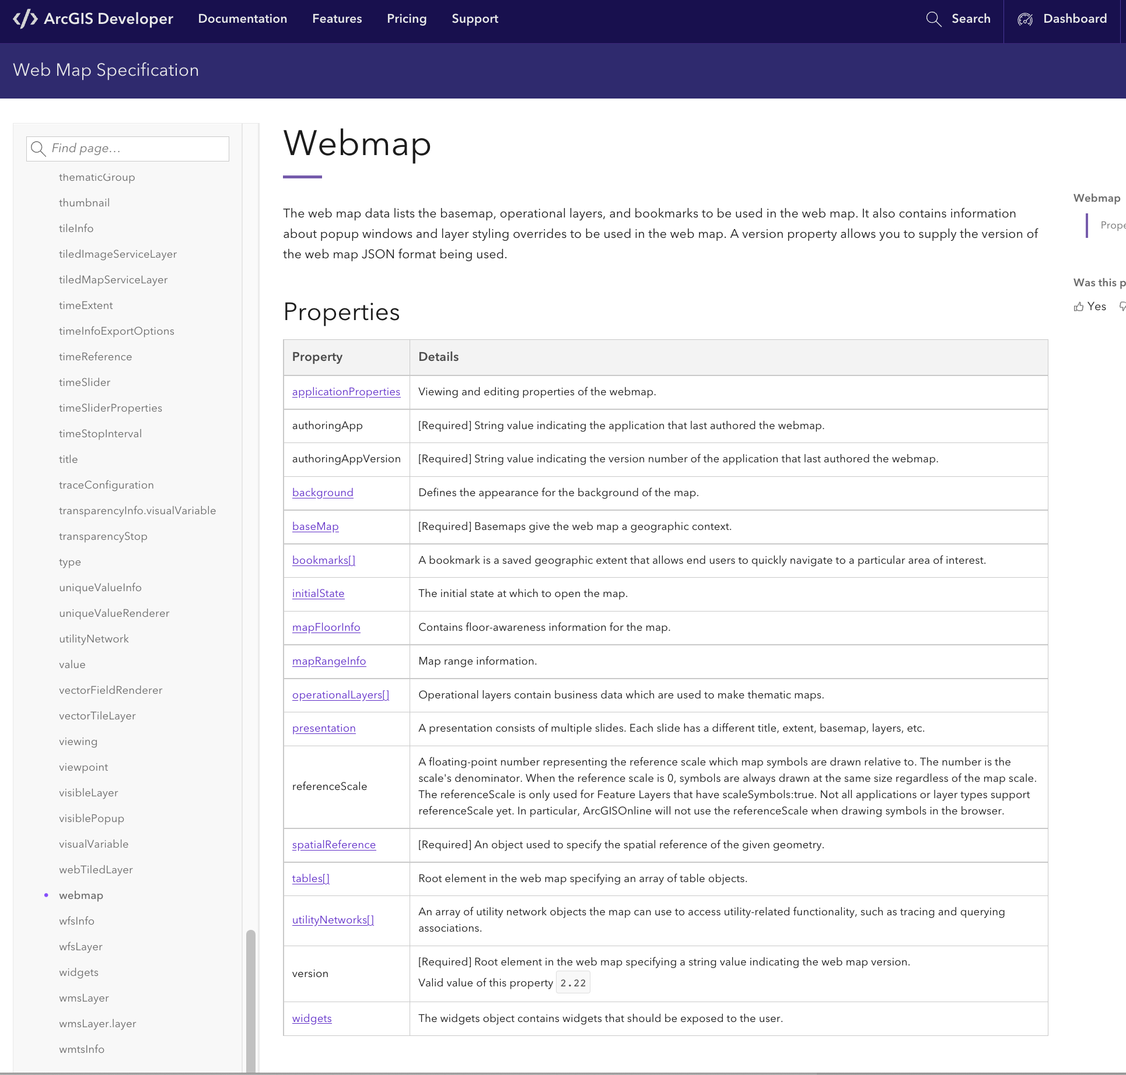
Documentation:
The Webmap Object
https://developers.arcgis.com/web-map-specification/

Slide 15
The WebMap Specification in API for Python
JSON object implementation maps to a Python dictionary

Slide 16
Access Web Maps
2 API Classes:
Item
WebMap
WebMap

Slide 17
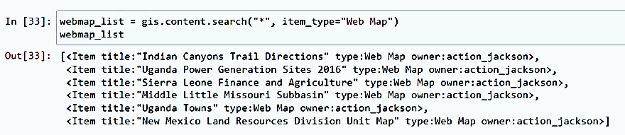
Item arcgis.gis module
List of items is returned from content searches:
gis.content.search(“*”, item_type=“Web Map”)

Slide 18
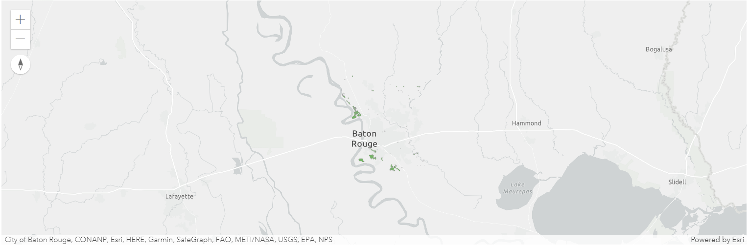
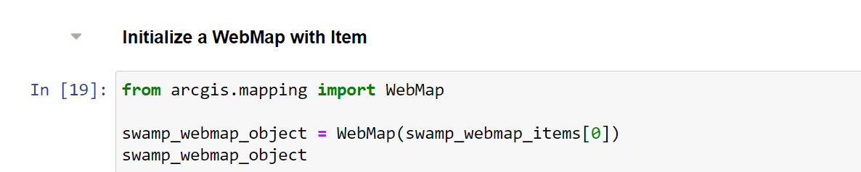
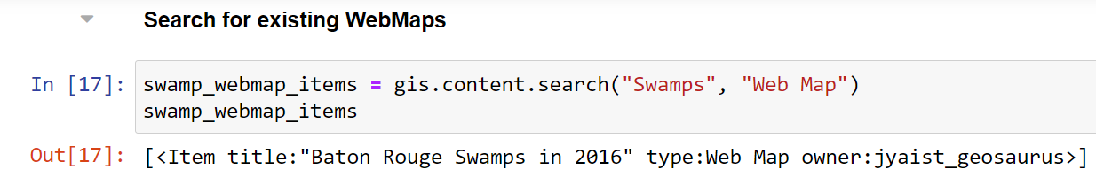
WebMap arcgis.mapping module
Initialize a WebMap object with an Item

Slide 19
Accessing the Web Map content
Item - get_data() method
WebMap – definition property

Slide 20
Demo: Editing Workflows
Basemaps and Popups

Slide 21
Demo: Switching Layers
Information Replacement

Slide 22
Demo: Feature Layers and Web Maps

Slide 23

Demo: Cloning a Web Map
Demo Presenter

Slide 24
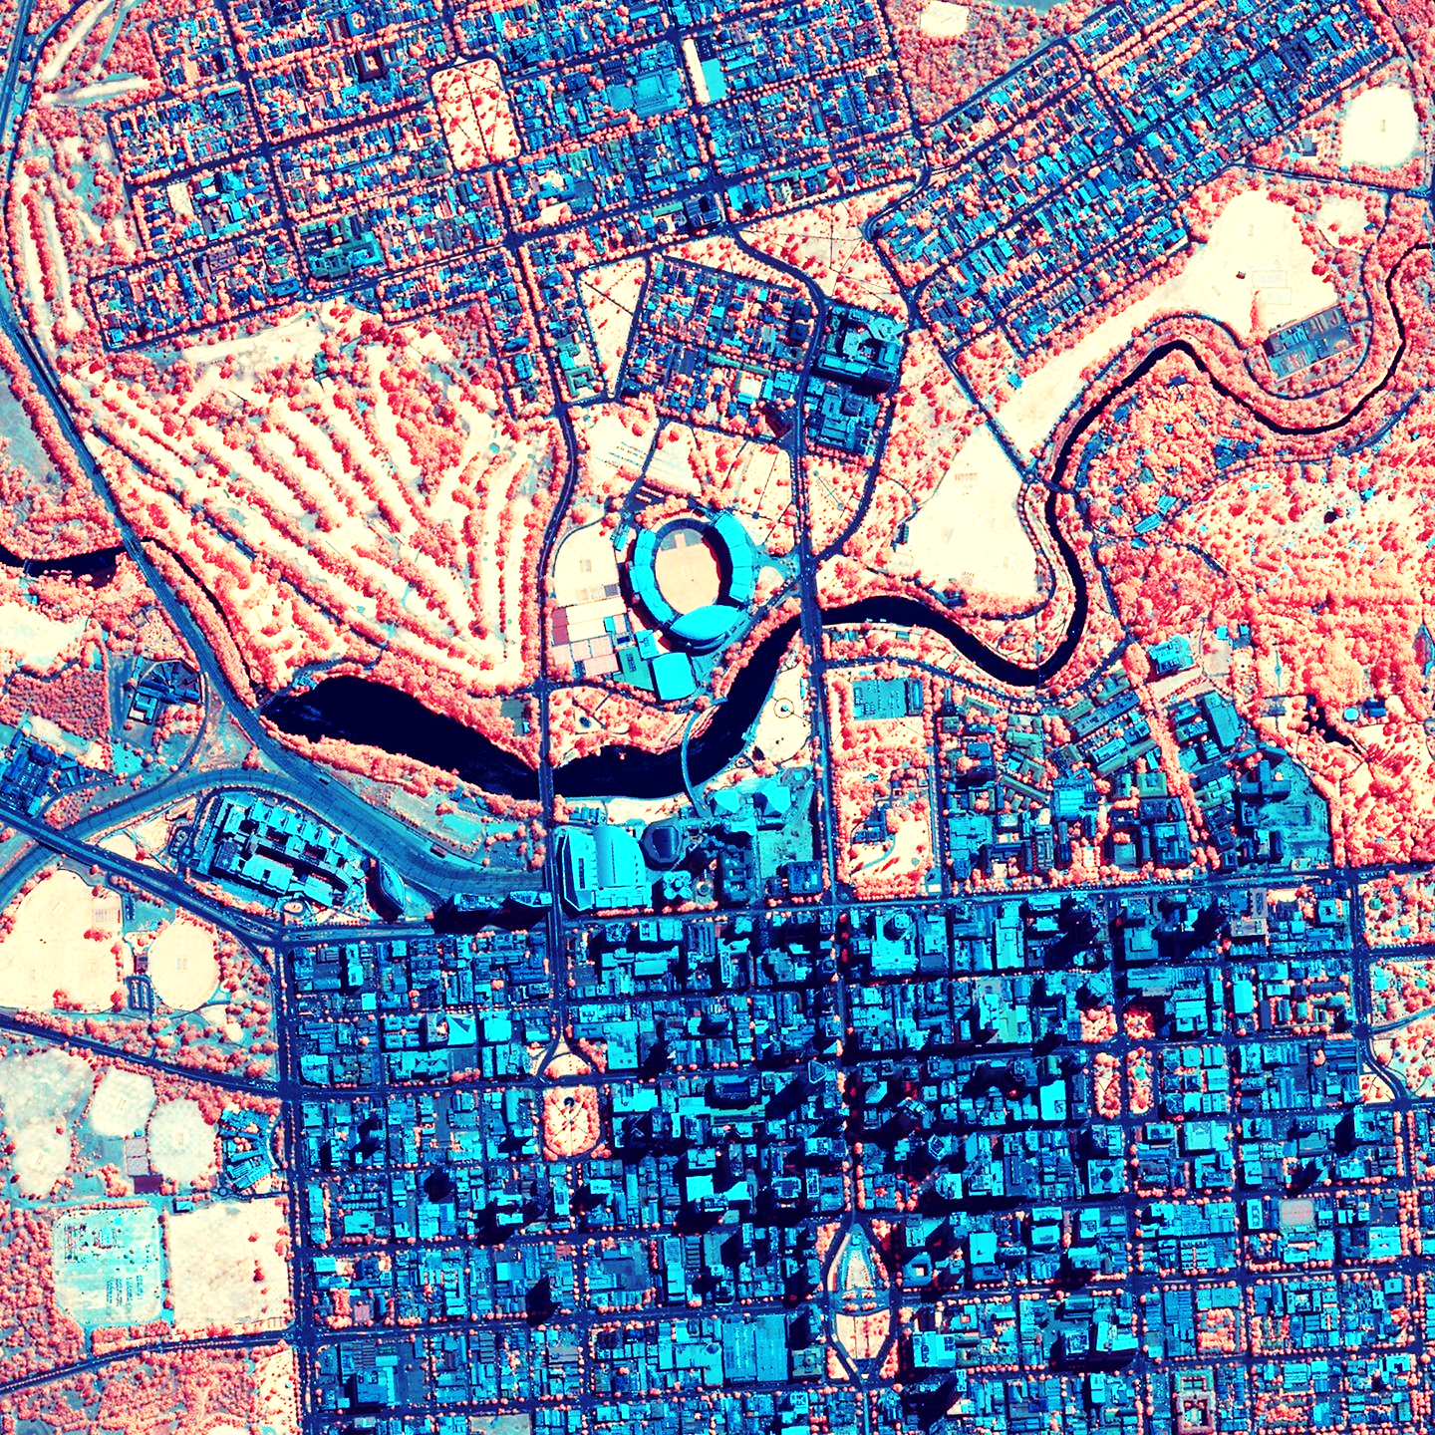
Resources

Slide 25
Documentation
Developer Website:
Items
ArcGIS REST API Website:
Items and item types
ArcGIS for Python API Reference:
Item

Slide 26



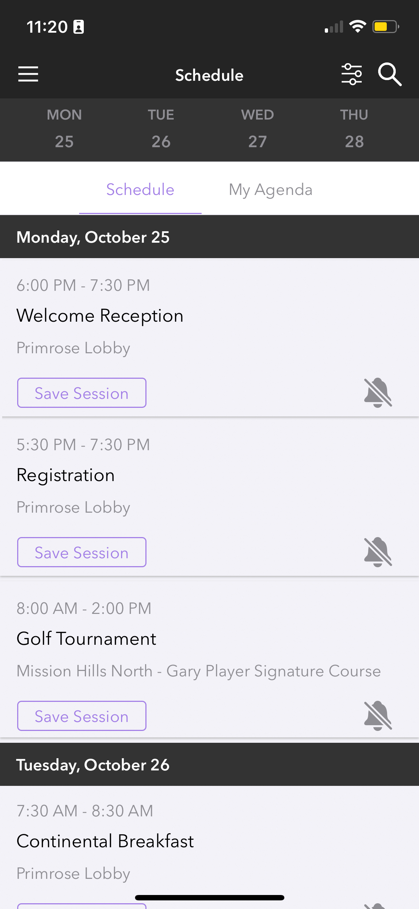
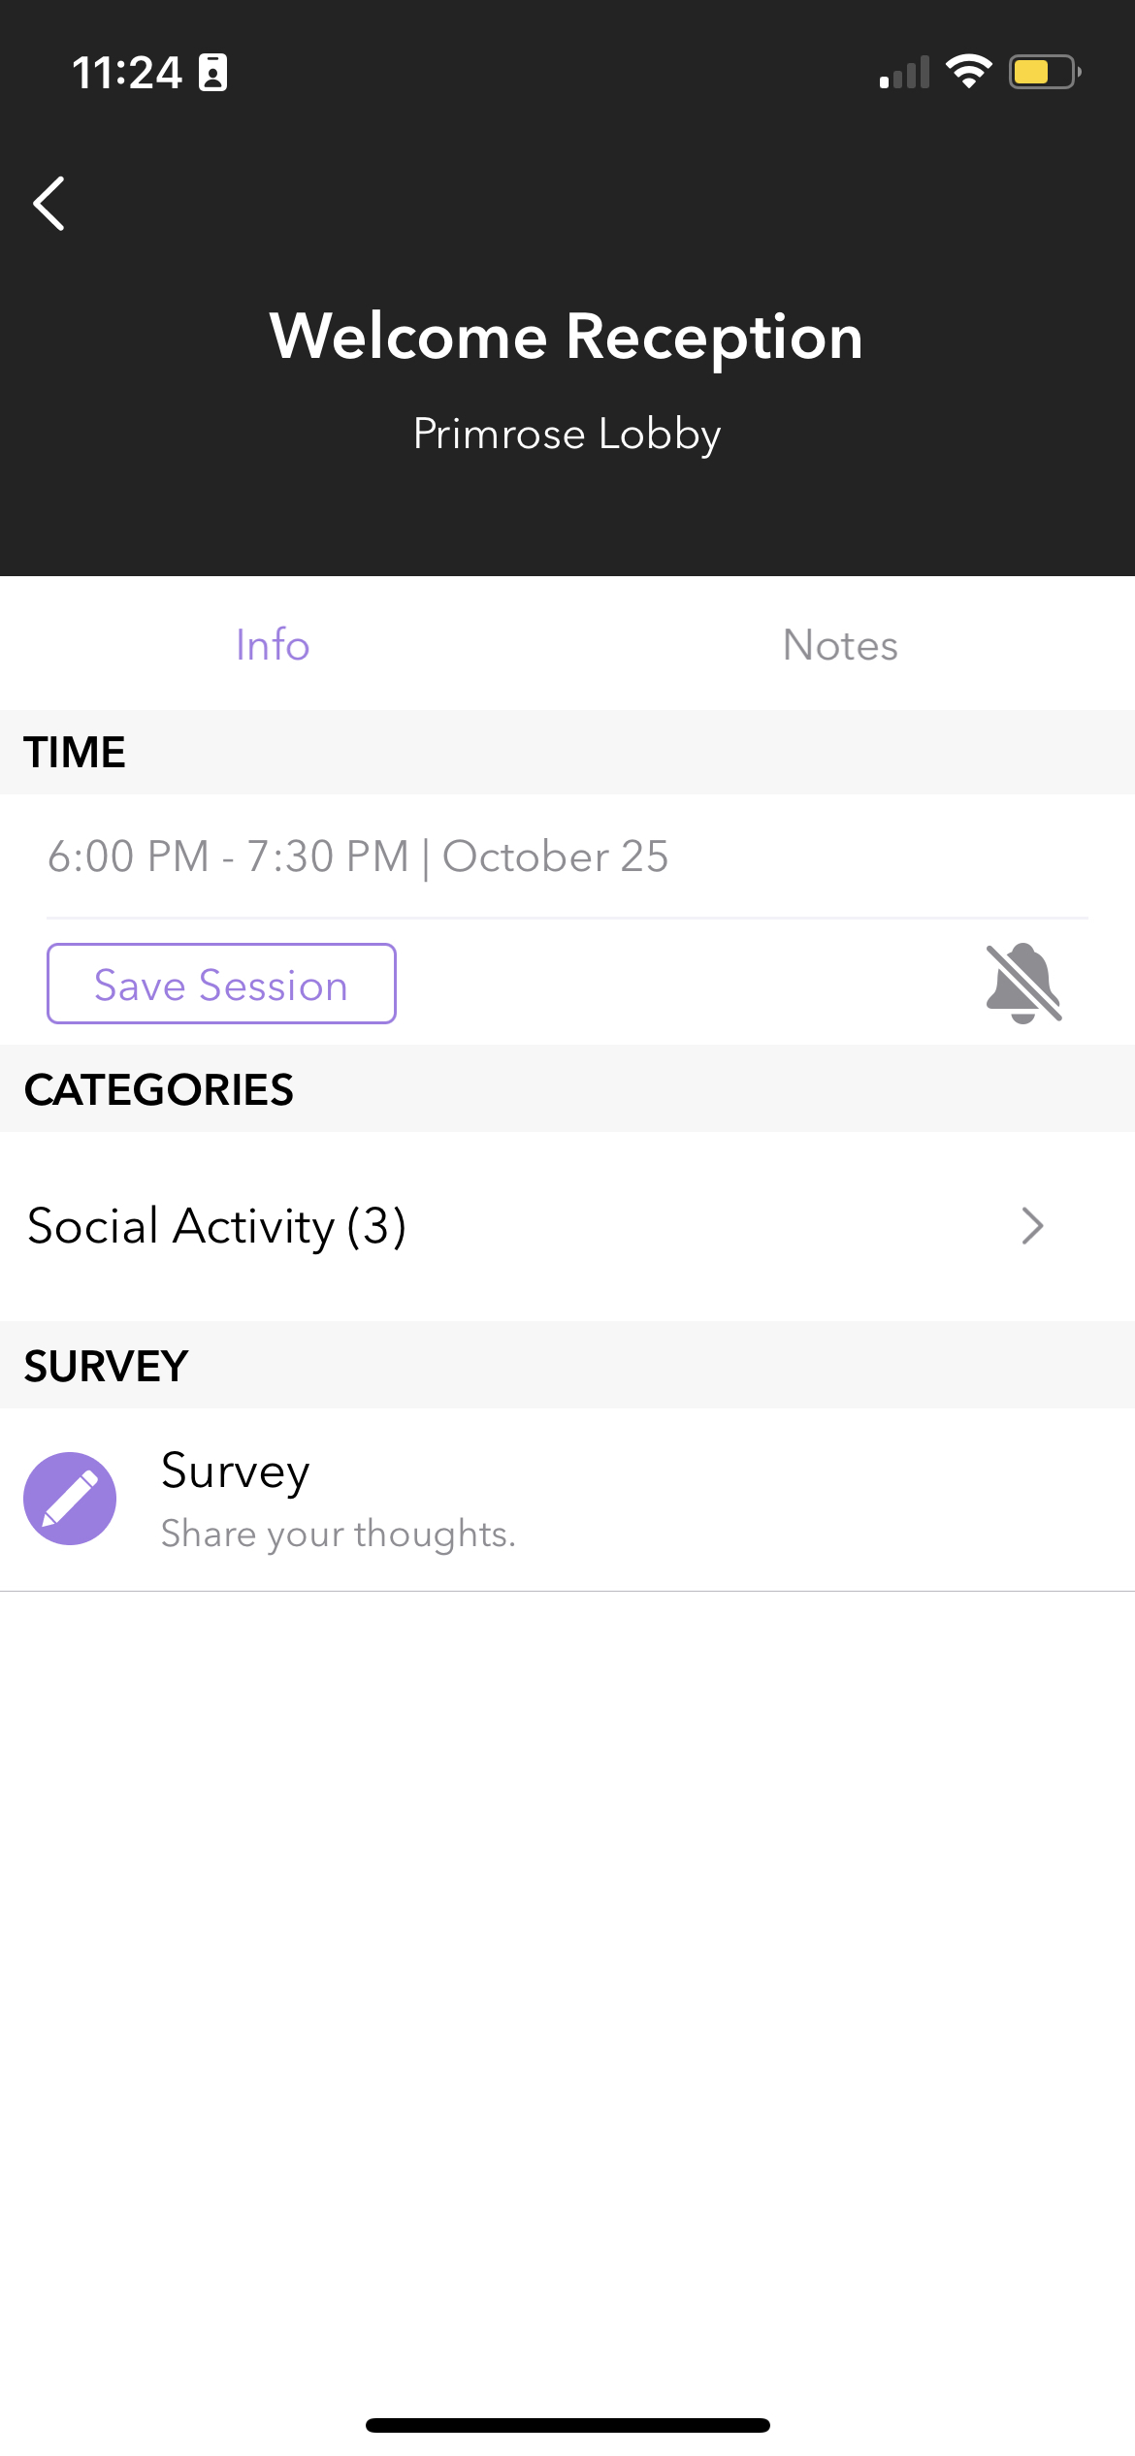
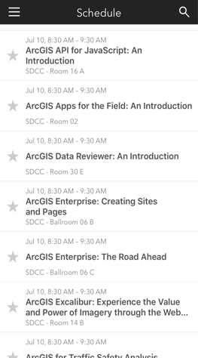
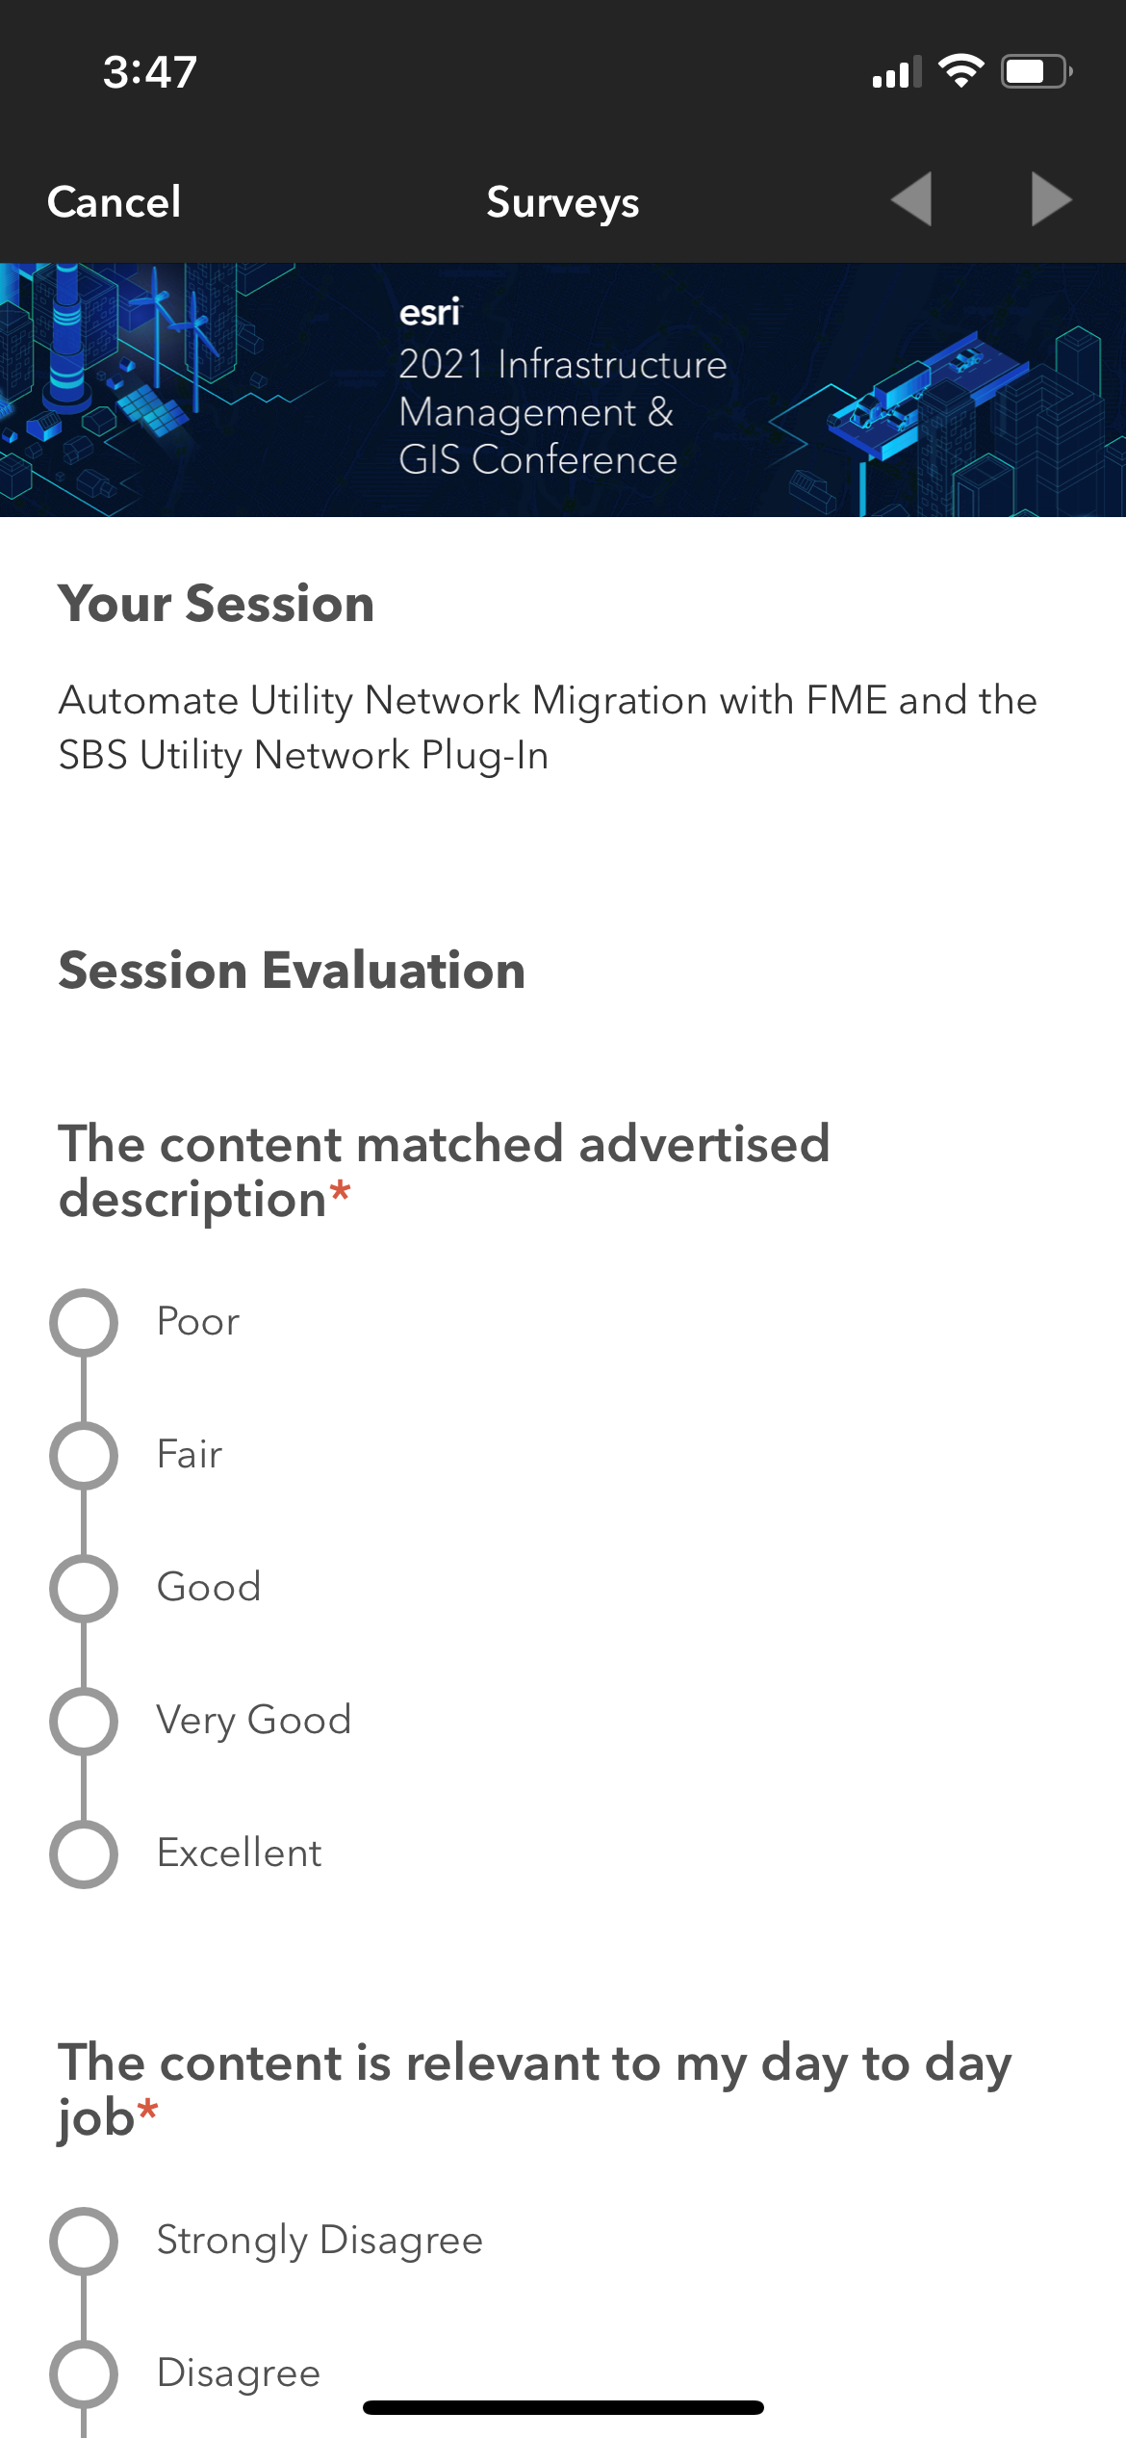
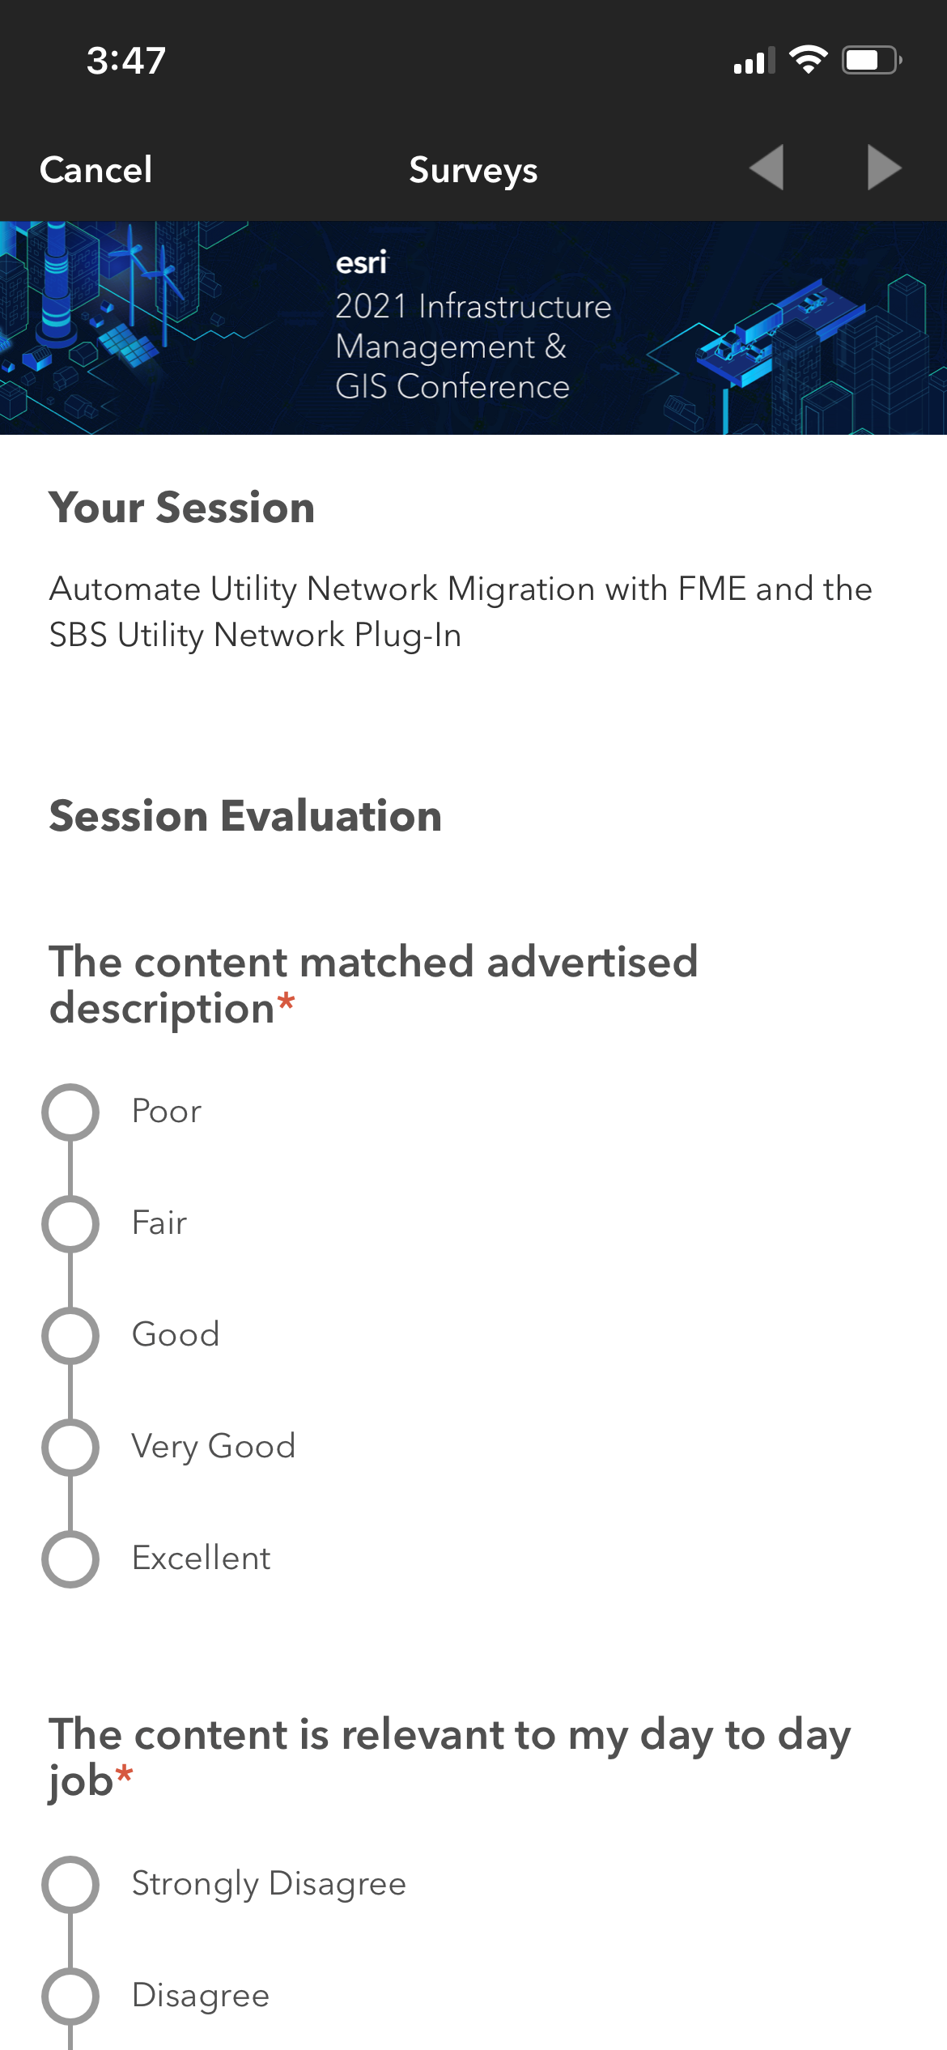
Please Share Your Feedback in the App
Download the Esri Events app and find your event
Select the session you attended
Scroll down to “Survey”
Log in to access the survey

Slide 27



Copyright © 2022 Esri. All rights reserved.

